Slide 1

Machine Learning in Game
P Sivakishore
20-May-2020

Slide 2
Who Am I ?
I‘m a Bluetooth verification Programmer for Client Intel.
Ex-Game Developer
Game Player

Slide 3
Agenda
Develop an Bot to play Tetris
Tetris Introduction
Game Algorithm (Min Max)
Solve Tic Tac Toe using MinMax
Try to use MinMax to develop Bot for Tetris
Introduction to Neural Network
Try to Use Convolutional neural network (CNN)
What is Convolutional Neural Network(CNN)
Develop Tetris Bot using CNN
Demo

Slide 4
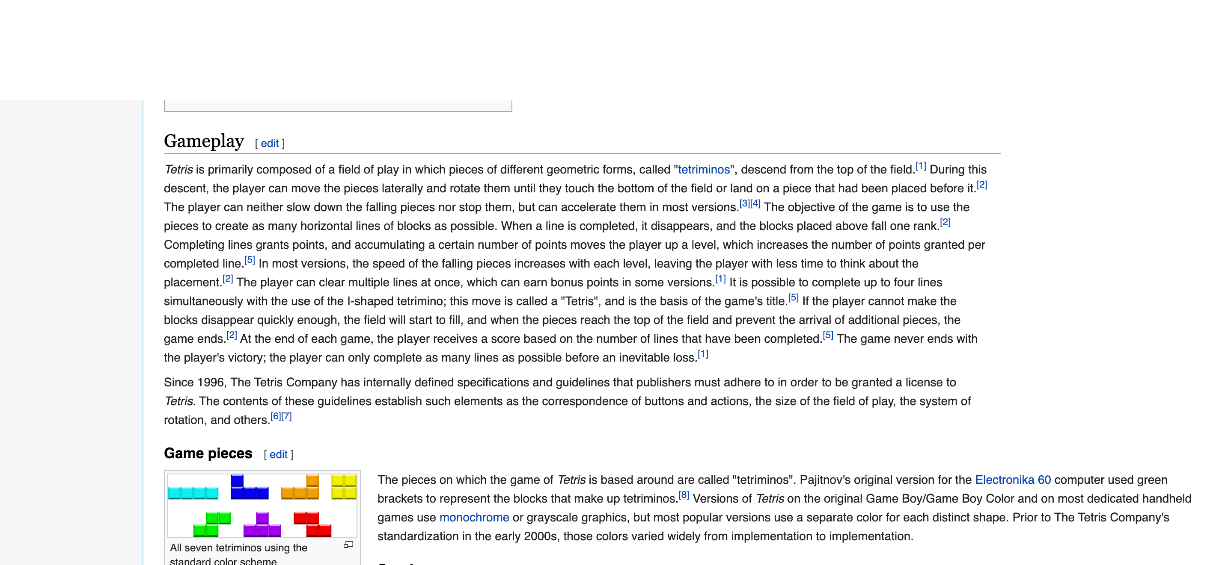
Tetris Introduction

Slide 5
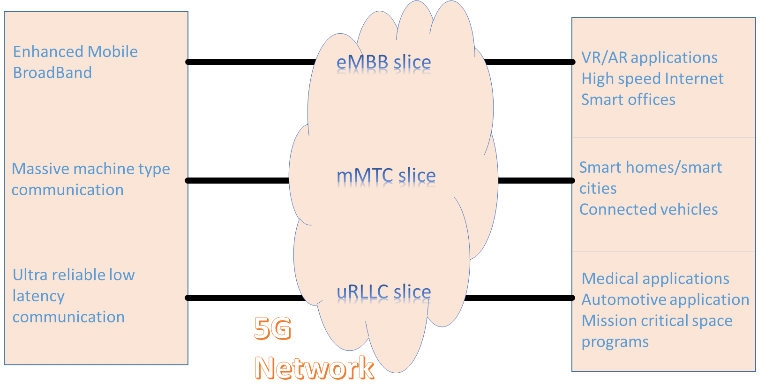
Introduction Continued…
Based on broad level requirements eMBB, mMTC and uRLLC are three basic slices.
5

Slide 6
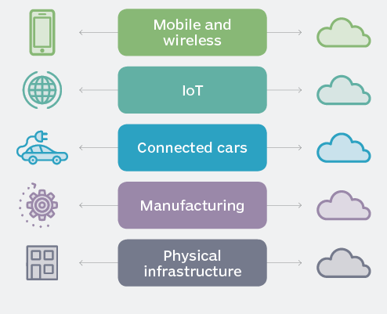
Different use cases
Network Slicing can be used for operational purposes by a single network operator, to differentiate characteristics and resources for different broad classes of services.
Network slicing can be used by a service provider seeking to establish a virtual service provider network over the infrastructure of a physical network operator
Network slicing can allow individual end customers to be able to customize a virtual network for their operations and consume network resources in a more dynamic way similar to today’s cloud services (i.e. dynamically varying scale, or for temporary needs).
Network slicing can allow for traffic splitting across networks (5G, 4G, and WiFi).

Slide 7
Motivation
Industry verticals relying on growing cellular network, for e.g.: (Social media, Multimedia entertainment etc.)
Single entity to cater multiple industry needs, for e.g.: (High bandwidth, ultra-high reliability, low latency)
High cost to build independent physical networks for specific needs
Optimal use of resources using single network

Slide 8
Requirements
A network slice can provide the functionality of a complete network, including RAN functions and CN functions. To achieve the network slicing, 5G system shall be able to create, modify and delete a network slice, define and update the set of services and capabilities for a network slice, identify UE and its service requirements and associate it to a network slice or remove it from a network slice.
As defined by 3GPP, network slicing requirements are related to below framework:
Provisioning: Create/modify/delete network slices, provision network functions to be used in network slice, define network services and capabilities supported by a network slice.
Managing association to slices: Configure association of devices and services to network slices, move/remove user between/from slices.
Interoperating: Support roaming and non-roaming using the same home slice, support devices simultaneously connected to multiple slices.
Supporting performance and isolation: Ensure performance isolation, enable operators to differentiate performance and functionalities between slices.

Slide 9
Common Terminologies
Network function | The elementary network functionalities that are used as building blocks to create every network slice, which has defined functional behavior and 3GPP defined interfaces
Network slice | A logical network that provides specific network capabilities and network characteristics
Network slice instance | A set of network function instances and the required resources which form a deployed Network Slice
Network slice type | These are high-level categories for NSIs, which reflect the distinct demands for network solutions. Three fundamental network slice types have been identified for 5G: eMBB, mMTC and URLLC
9

Slide 10
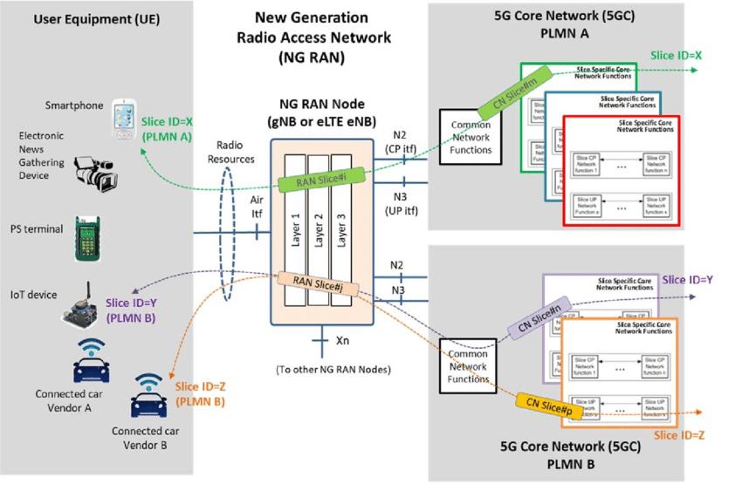
Network slice Architecture

Slide 11
Brief overview of Network slicing - Network side
11

Slide 12
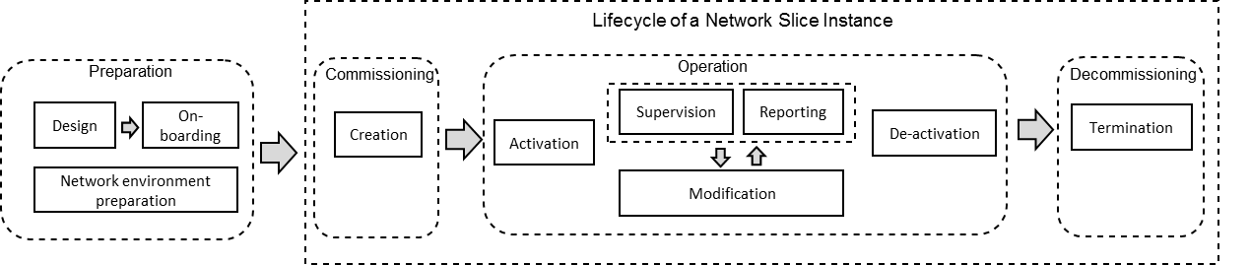
NSI lifecycle
NSI represents the implementation perspective of a network slice. An NSI is composed of one or several Network Slice Subnet Instance(s) (NSSI(s)) for e.g. An NSI can be formed by a NSSI with the RAN functions and another NSSI with the 5GC functions. The lifecycle management of NSIs consists of four phases i.e. preparation, commissioning, operation and decommissioning, with one or several tasks in each of them.
12

Slide 13
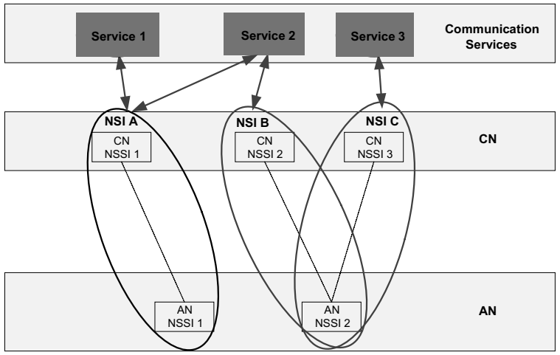
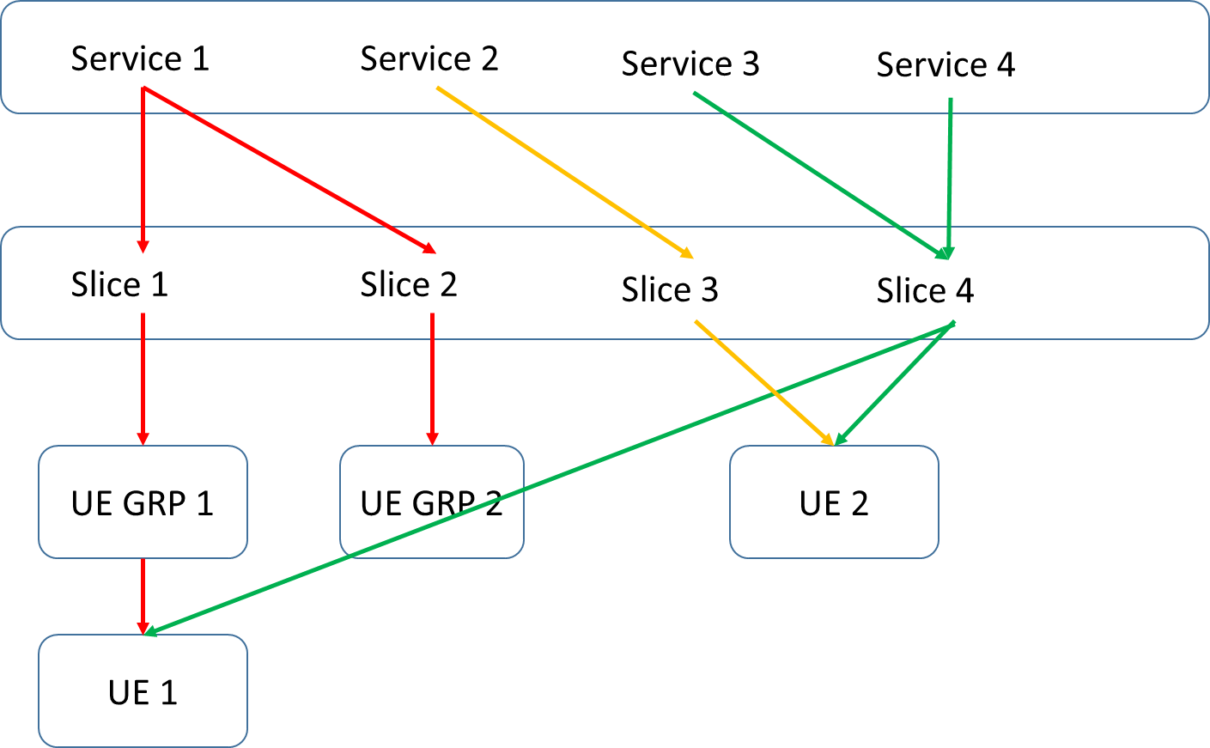
Service Concepts
13
Notes:
The operator can deploy multiple network slice instances delivering exactly the same features but for different groups of UEs.
The network may serve a single UE with one or more network slice instances simultaneously.
Number of simultaneous connection of network slices per UE is limited by the number of S-NSSAIs in the requested/allowed NSSAI and capped at max 8 at a time.
The selection of the set of network slice instances for a UE is triggered by the first contacted AMF in a Registration procedure

Slide 14
Registration and Subscription concepts
When a UE registers over an access type with a PLMN, if the UE for this PLMN has a configured NSSAI or for this PLMN and the access type has an allowed NSSAI, the UE shall provide to the network in AS layer and NAS layer a requested NSSAI containing the S-NSSAI(s) corresponding to the slice(s) to which the UE wishes to register.
The AN shall route the NAS signaling between this UE and an AMF selected using the requested NSSAI obtained during RRC connection establishment. If the AN is unable to select an AMF based on the requested NSSAI, it routes the NAS signaling to AMF from a set of default AMFs.
When the AMF selected by the AN receives the UE registration request the AMF may query the UDM to retrieve UE subscription information including the subscribed S-NSSAIs.
The network verifies the requested NSSAI the UE provides in the registration request against the subscription Information. For this, AMF verifies whether the S-NSSAI(s) in the requested NSSAI are permitted based on the subscribed S-NSSAIs.
Based on operator's policy, one or more subscribed S-NSSAIs can be marked as a default S-NSSAI.
If an S-NSSAI is marked as default, then the network is expected to serve the UE with a related applicable network slice instance when the UE does not send any valid S-NSSAI to the network in a registration request message as part of the requested NSSAI.
When there is a need to update the allowed NSSAI, the AMF shall provide the UE with a new allowed NSSAI.
The UE might also obtain one or more rejected S-NSSAIs with cause and validity of rejection from the AMF.
14

Slide 15
Brief overview of Network slicing - UE side
15

Slide 16
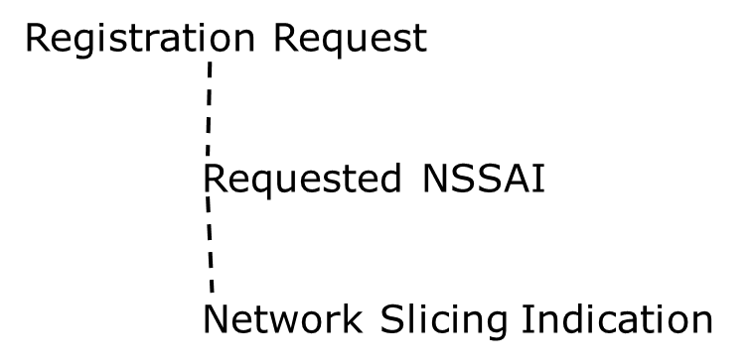
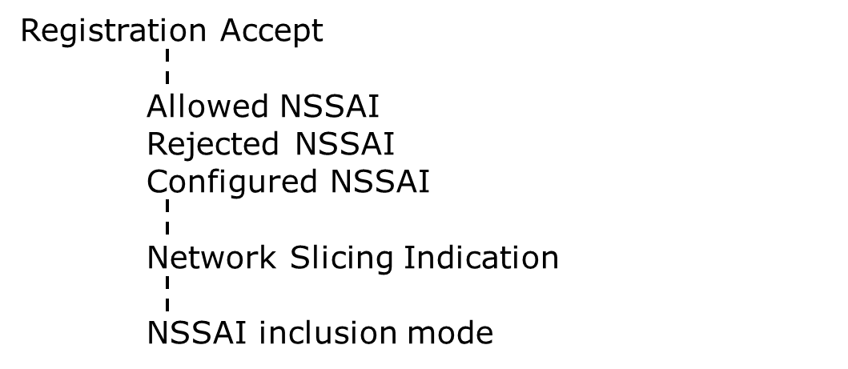
NAS impact and understanding
Registration Request | With registration request, NAS provides network with requested NSSAI (if available). Based on the subscription information, 5G network is responsible for selection of a network slice instance(s) to serve the UE. IEs related to network slicing in registration request are: Requested NSSAI and Network slicing indication.
Registration Accept | With registration accept, network provide/configure UE with allowed, configured, rejected or default NSSAI information. IEs related to network slicing in registration request are: Allowed NSSAI, Rejected NSSAI, Configured NSSAI, Network slicing indication and NSSAI inclusion mode.
16

Slide 17
NAS impact and understanding continued…..
Requested NSSAI | UE adds this IE in registration request for initial registration and mobility registration updating only and UE has a configured or allowed NSSAI for the current PLMN. If both of the NSSAI not available and UE has a default configured NSSAI, then default configured NSSAI will be added. This is of type NSSAI.
Allowed NSSAI | Network (AMF) adds this IE in registration response, if network allows one or more S-NSSAIs, received with registration request. If nothing received with requested NSSAI or none of the requested S-NSSAIs present in subscription list, and network has one or more S-NSSAIs marked as default, then default will be added with allowed NSSAI. This is of type NSSAI.
Configured NSSAI | Network (AMF) adds this IE in registration response, if a new NSSAI needs to be configured for current PLMN. This is of type NSSAI.
Rejected NSSAI | Network (AMF) adds this IE in registration response, if any S-NSSAI added sent with requested NSSAI is rejected by network.
Network slicing indication | This information element is to indicate additional information associated with network slicing. UE -> NW: This contains network slicing subscription change information. N/W -> UE: This contains default configured NSSAI information.
NSSAI inclusion mode | The purpose of the NSSAI inclusion mode IE is to indicate the NSSAI inclusion mode in which the UE shall operate out of mode A, mode B, mode C and mode D.
17

Slide 18
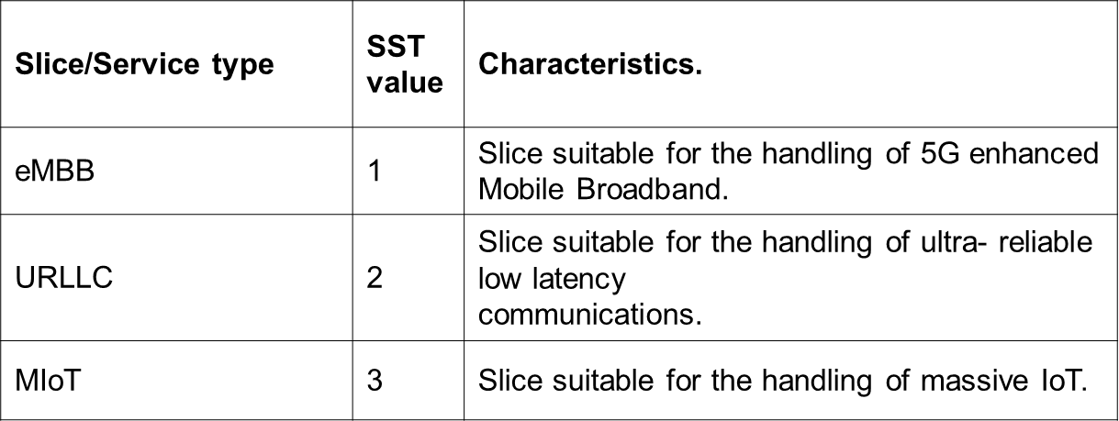
NAS impact and understanding continued…..
Network Slice Selection Assistance Information (NSSAI) | It is a collection of S-NSSAIs. NAS interacts with network by using NSSAIs. An NSSAI is a collection and S-NSSAIs and the purpose of NSSAI information element is to identify a collection of S-NSSAIs.
Single Network Slice Selection Assistance Information (S-NSSAI) | S-NSSAI is a combination of slice/service type (SST) and slice differentiator (SD).
Slice/Service type (SST) | The expected Network Slice behaviour in terms of features and services. This is 8-bit value and can have standard (0–127) or operator specific (128-255) value.
Slice Differentiator (SD) | This is optional field and differentiate slices with same SST value
18

Slide 19
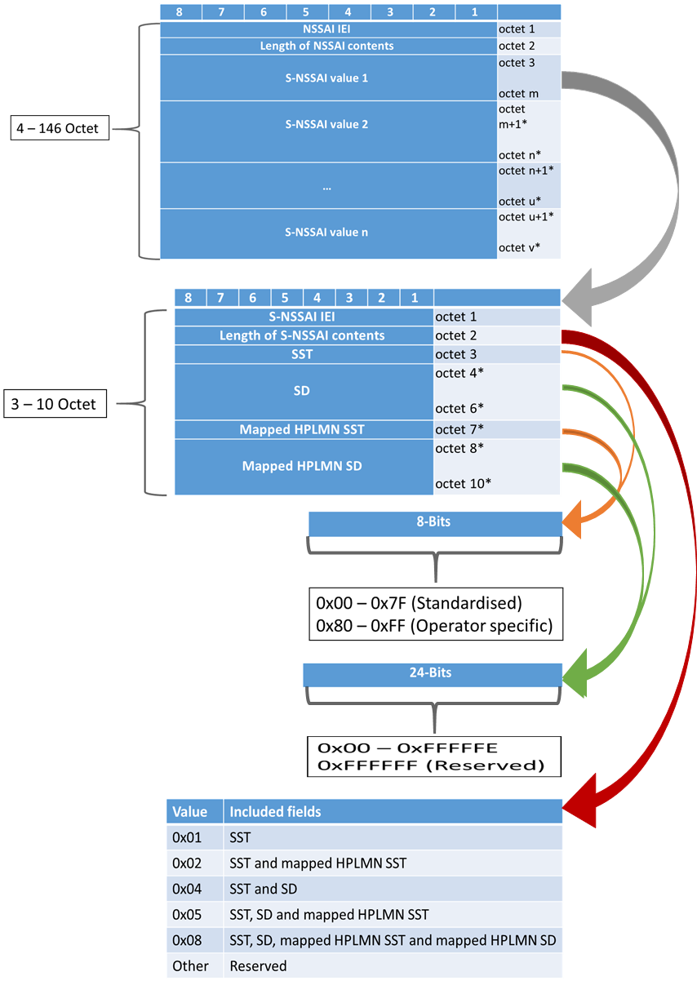
NSSAI Structure (Requested/Configured/Allowed)
19

Slide 20
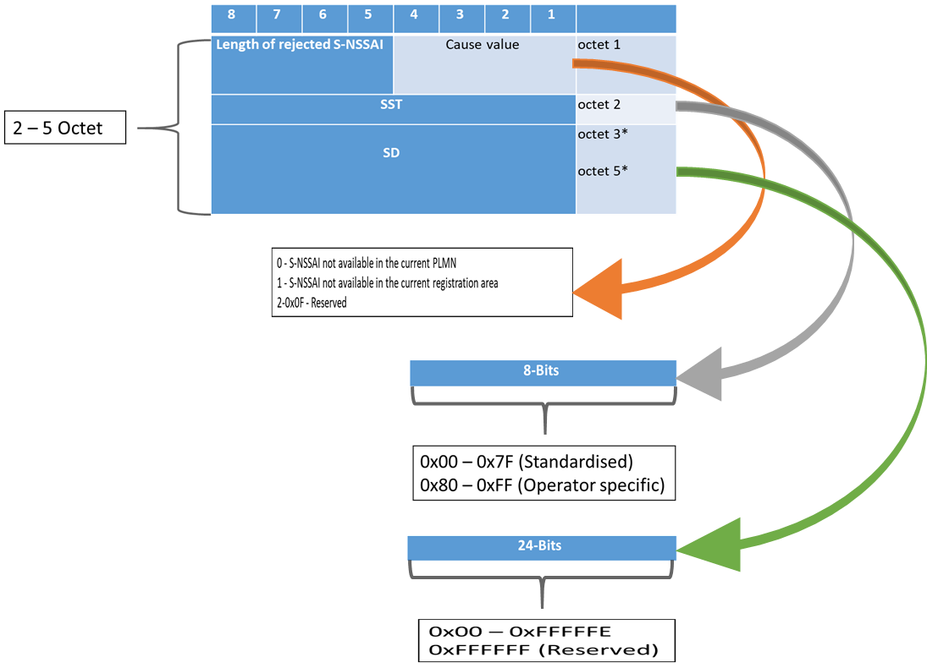
NSSAI Structure (Rejected)
20

Slide 21
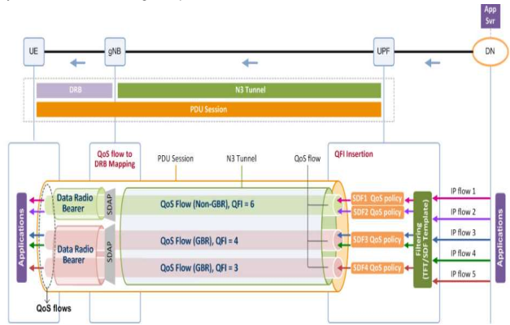
SDAP (PDU session)
SDAP is placed on top of PDCP and is responsible for transfer of user plane data and handling QoS flow over 5G air interface. SDAP will map specific QoS flow to a particular DRB within a PDU session. One PDU session may contain multiple QoS flows and several DRBs but only a single entity of SDAP will be configured per PDU session.
21
Notes:
In 5G, QoS is enforced at the QoS flow level. A flow is the finest granularity of QoS differentiation. There is a single user plane network function (UPF) for transport of data between the gNB and the core network. There is a one-to-many relationship between the GTP-U tunnel on N3 and the DRBs on the air interface i.e. one tunnel can contain multiple DRBs. The gNB may map individual QoS flows to one or more DRB. Also a DRB can transport one or more QoS flows.
PDU session is made by a sequence of NG tunnels in 5GC, and of one or more radio bearers on the radio interface. A PDU Session belongs to one and only one specific network slice instance per PLMN. Different network slice instances do not share a PDU Session.

Slide 22
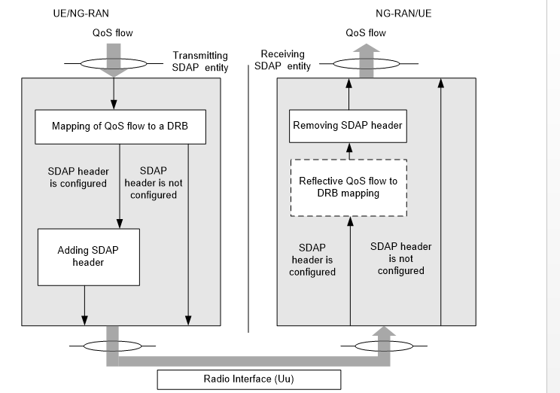
SDAP (QOS flow handling)
SDAP layer is configured by RRC to map QOS flows to DRBs. One or more QOS flows can be mapped to same DRB. For each pdu session, UE will have separate SDAP entity and there can be multiple sdap-config present for each pdu session.
If DL-SDAP header is configured, reflective QOS flow to DRB mapping is performed by UE. For this, UE monitors the QOS flow to DRB mapping rule in the DL, and applies it to in the UL.
22

Slide 23
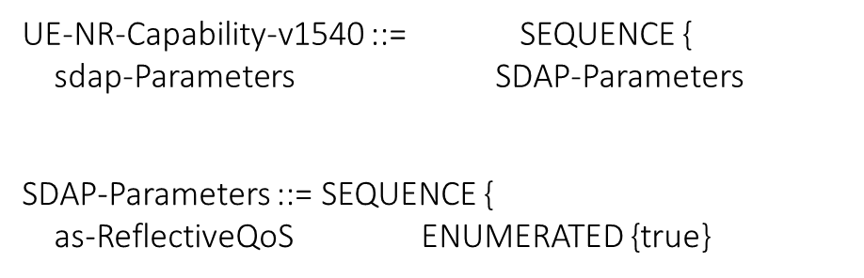
RRC (UE Capability impact)
RRC provides SDAP capabilities using SDAP-Parameters IE with ueCapabilityInformation.
23

Slide 24
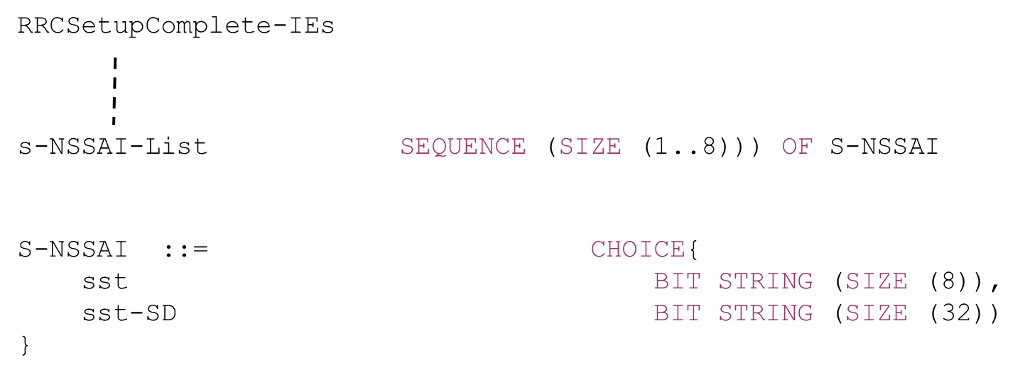
RRC (rrcSetupComplete)
if upper layers provide one or more S-NSSAI, include the s-NSSAI-List and set the content to the values provided by the upper layers
24

Slide 25
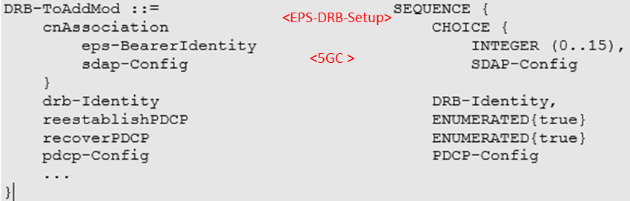
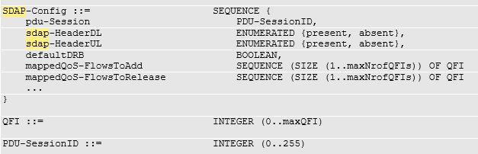
RRC (SDAP configuration)
The SDAP configuration determines how to map QoS flows to DRBs, when NR or E-UTRA connects to the 5GC.
25
Notes:
PDU Session: Identity of the PDU session whose QoS flows are mapped to the DRB.
defaultDRB: Indicates whether or not this is the default DRB for this PDU session.
One PDU session can have multiple DRB-Ids mapped to it.
For each DRB, one SDAP-Config is received.
In multiple SDAP-Config same value of pdu-session can be present but defaultDRB will be TRUE for only one instance of SDAP-Config
Normally, multiple flows can be mapped to same DRB-Id.
sdap-HeaderUL: Indicates whether or not a SDAP header is present for UL data on this DRB.
sdap-HeaderDL: Indicates whether or not a SDAP header is present for DL data on this DRB.
mappedQoS-FlowsToAdd: Indicates the list of QFIs of UL QoS flows of the PDU session to be additionally mapped to this DRB.
QFI is unique within a pdu-session and a QFI value can be included at most once in all configured instances of SDAP-Config with the same value of pdu-Session. For QoS flow remapping, the QFI value of the remapped QoS flow is only included in mappednew DRB and not included in mappedQoS-FlowsToRelease in sdap-Config corresponding to the old DRBQoS-FlowsToAdd in sdap-Config corresponding to the old DRB.
mappedQoS-FlowsToRelease: Indicates the list of QFIs of QoS flows of the PDU session to be released from existing QoS flow to DRB mapping of this DRB.

Slide 26
RRC (Handing of SDAP Configuration)
Addition | RadioBearerConfig includes the drb-ToAddModList, that is not part of the current UE configuration and an sdap-Config is included
Modification | RadioBearerConfig includes the drb-ToAddModList, that is part of the current UE configuration and an sdap-Config is included.
Release | RRCSetup in response to RRCResumeRequest Inter-RAT handover to NR with full config (When UE connected to 5GC) For each drb-Identity value included in the drb-ToReleaseList that is part of the current UE configuration and SDAP entity associated with this DRB For each drb-Identity value included in the drb-ToReleaseList that is to be released as the result of full configuration and SDAP entity associated with this DRB Upon going to idle state Successful completion of the mobility from NR
Suspend | Upon going to inactive state While performing Inter-RAT handover to NR without full config (When UE connected to 5GC)
Resume | Inter-RAT handover to NR without full config (When UE connected to 5GC) RRCResume in response to RRCResumeRequest
26

Slide 27
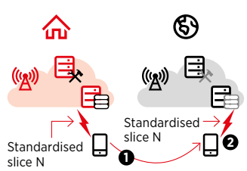
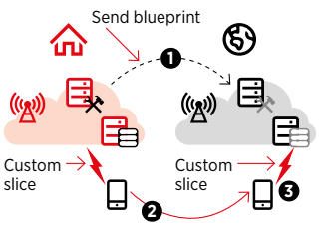
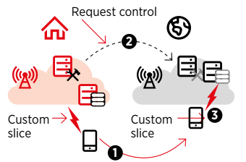
Mobility handling
For seamless mobility and slice handling over roaming areas, there are few provisions provided for operators as Standardized slices, Blueprint export and Virtual home slice configuration.
27
Notes:
Standardized slices: Roaming partners can form a common set of slices that provides standardized services. So, when device visits a roaming area, network configures that standardized slice for visited user.
Blueprint export: Home network exports slice template to visited roaming partner. So, when device visits a roaming area, network configures the identical slice for visited user similar to the home network.
Virtual home slice configuration: Home network requests and take control of visited network resources. So, when device visits a roaming area, network configures the same slice for visited user as when at home network.

Slide 28
References
3GPP Specification: 24.501 - Non-Access-Stratum (NAS) protocol for 5G System (5GS)
3GPP Specification: 23.003 - Numbering, addressing and identification
3GPP Specification: 28.801 - Telecommunication management; Study on management and orchestration of network slicing for next generation
3GPP Specification: 28.531 - Management and orchestration; Provisioning
3GPP Specification: 38.331 - NR; Radio Resource Control (RRC); Protocol specification
3GPP Specification: 37.324 - Evolved Universal Terrestrial Radio Access (E-UTRA) and NR; Service Data Adaptation Protocol (SDAP) specification
3GPP Specification: 23.502 - Procedures for the 5G System (5GS)
https://www.wwrf.ch/files/wwrf/content/files/publications/outlook/White%20Paper%203-End%20to%20End%20Network%20Slicing.pdf
https://www.gsma.com/futurenetworks/wp-content/uploads/2017/11/GSMA-An-Introduction-to-Network-Slicing.pdf
https://netmanias.com/en/post/oneshot/14105/5g/5g-qos
https://www.5gitaly.eu/2018/wp-content/uploads/2019/01/5G-Italy-White-eBook-Functional-architecture.pdf
28

